Slide 1
KYTC’s Highway Information System (HIS) Helping You Jump Start Your Planning and Design Data Gathering Efforts
Josh Wentz
KYTC Division of Planning
Data Management Branch Manager

Slide 2
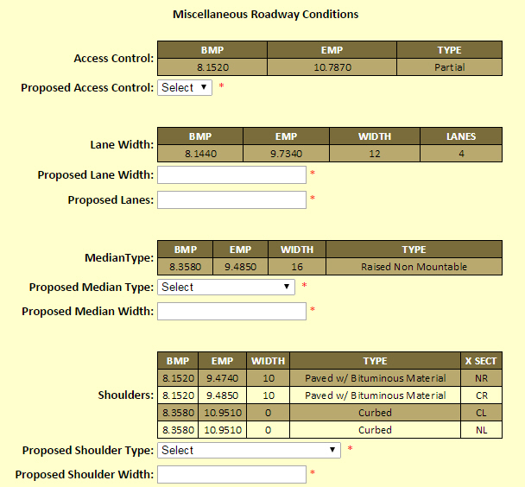
Needs for Existing Data
Project Identification Form (PIF)

Slide 3
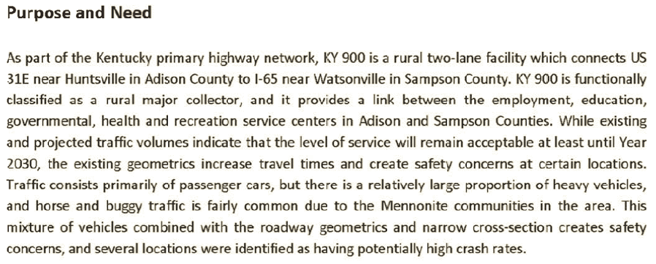
Needs for Existing Data
Purpose and Need Statement

Slide 4
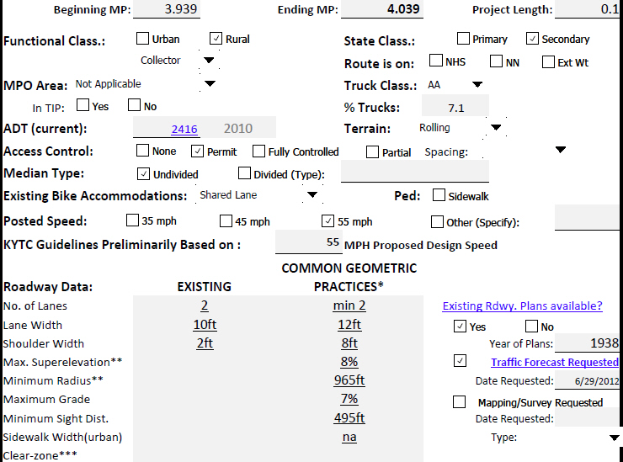
Needs for Existing Data
Data Needs Analysis Study (DNA)

Slide 5
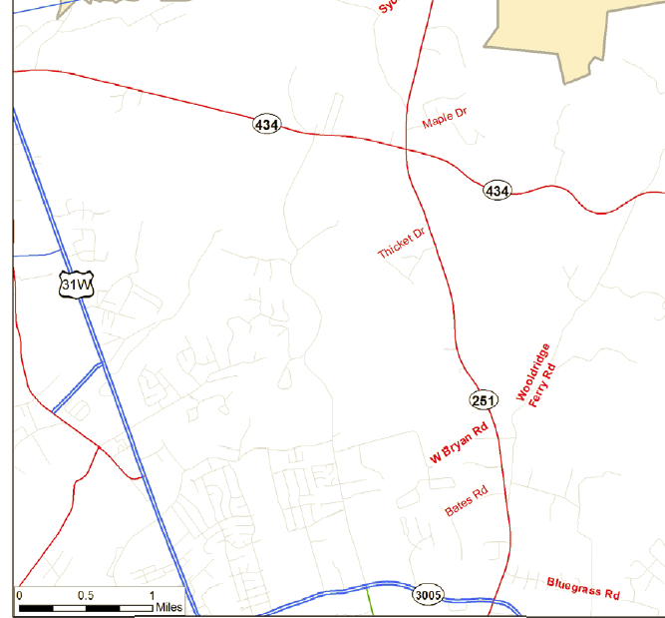
Needs for Existing Data
Planning Study

Slide 6
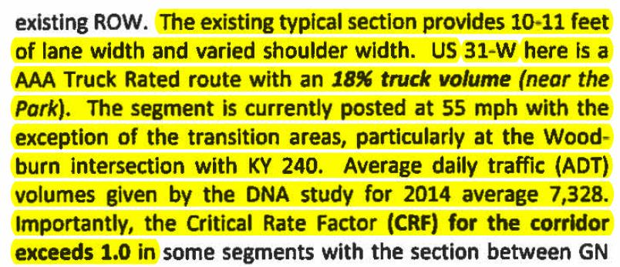
Needs for Existing Data
Project Approach

Slide 7
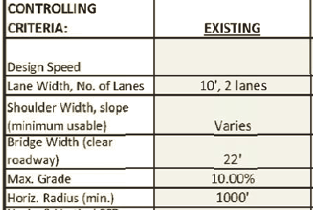
Needs for Existing Data
Design Executive Summary (DES)

Slide 8
Session Plan
HIS Overview – What’s in it?
Demo – HIVEi
Usage Limitations
Future Enhancements

Slide 9
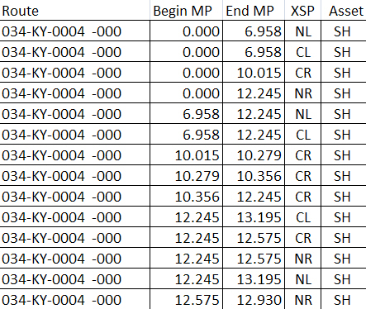
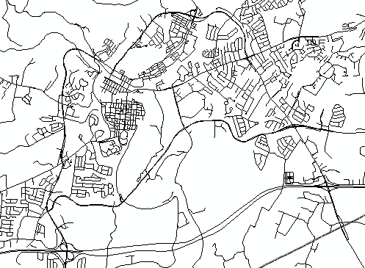
Two Major Components
HIS
Tabular Road Data
Road Centerlines

Slide 10
Road Centerlines
Spatial/GIS representation of all public road centerlines
KYTC, County, City, State Agencies, Federal
88,000 miles
Dual-carriageway
Linear Referencing System (LRS)
County, Route, & Milepoint locations

Slide 11
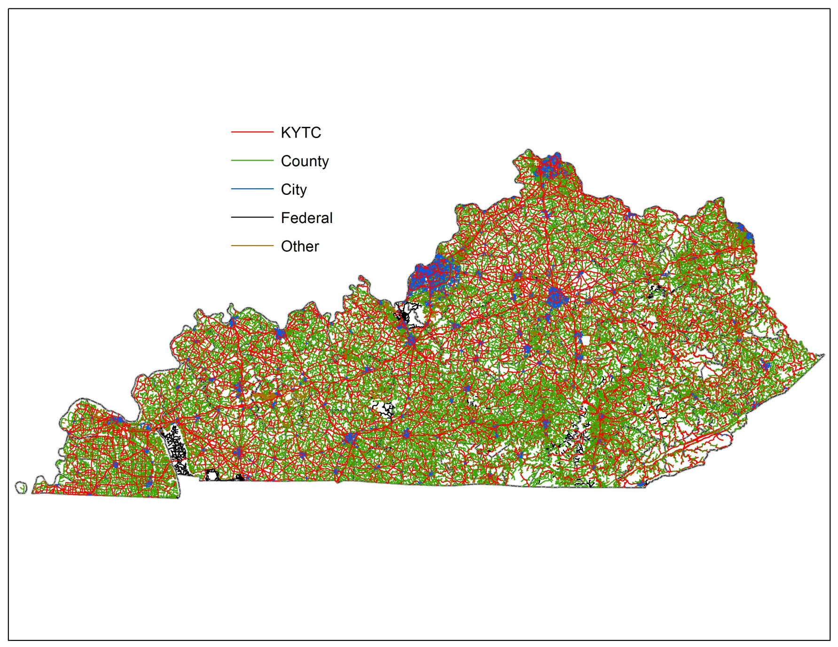
Road Centerlines

Slide 12
Road Centerlines
Attribute | Comments
Route Unique | County #, Rt Prefix, Rt #, Rt Suffix, and Rt Section
Begin Milepoint
End Milepoint
Road Name | As provided by local agencies
Surface Type
DMI Length | In miles, 3 decimal places
Government Level | Road ownership indicator
Type of Operation | 1-way, 2-way, Divided

Slide 13
Tabular Road Data
48 data tables
440 attributes
8 data owners
14 data custodians
Varying extents, update cycles, and levels of access

Slide 14
Tabular Road Data - Highway Systems
Table | Data Owner
Appalachian Development Highway System | Planning
Coal Haul Highway System | Planning
Drive Smart Corridors | Highway Safety
Extended Weight System | Planning
Forest Highway System | Planning
Federal Systems (Functional Classification, NHS, Strahnet) | Planning
Scenic Byway System | Local Programs
State Primary Road System | Planning
National Truck Network | Planning

Slide 15
Tabular Road Data - Roadway Information
Table | Data Owner
Access Control | Planning
Evaluation Sections (Homogenous Road Sections) | Planning
Type of Operation | Planning
Route Log (Intersection Information) | Planning
Speed Limit | Traffic Operations
Truck Weight Classification | Maintenance

Slide 16
Tabular Road Data - Roadway Features
Table | Data Owner
Auxiliary Lanes (Turn, TWLTL, Truck Climbing) | Planning
Bicycle and Pedestrian Facilities | Planning
Horizontal Curves | Planning
Vertical Curves / Grades | Planning
Through Lanes | Planning
Medians | Planning
Shoulders | Planning

Slide 17
Tabular Road Data - Other
Table | Data Owner
Traffic (AADT, Truck Counts/%, Station Info) | Planning
International Roughness Index (IRI) | Maintenance
Pavement Management (Year of Resurfacing, Thickness, Structural #) | Maintenance

Slide 18
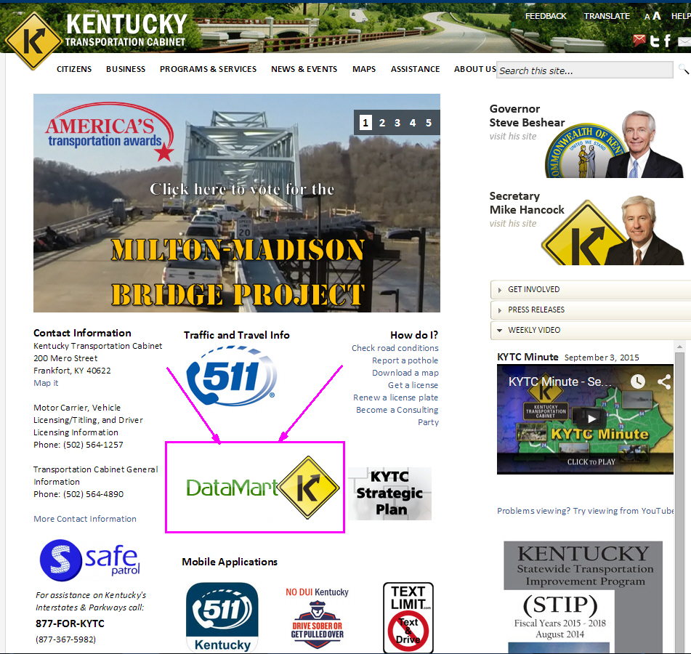
Highway Information View and Extract Interface

Slide 19
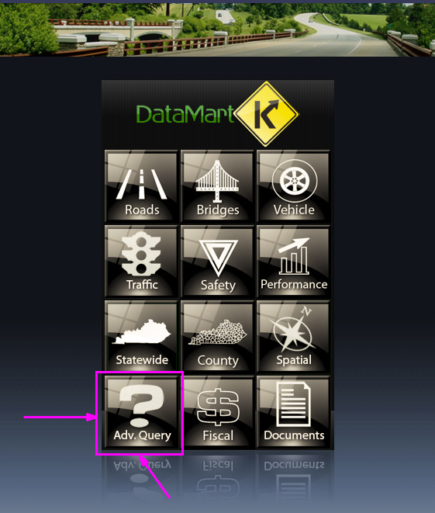
Highway Information View and Extract Interface

Slide 20
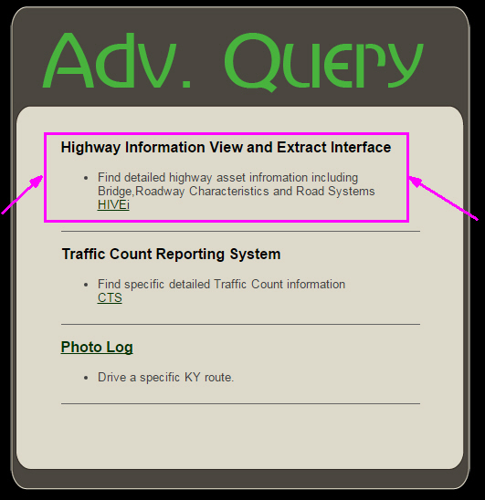
Highway Information View and Extract Interface

Slide 21
Highway Information View and Extract Interface
http://datamart.business.transportation.ky.gov/EDSB_SOLUTIONS/hisextracts/

Slide 22
Usage Limitations
“Qualified customers only. Available only at participating authorized dealers. Subject to credit approval.”
“Qualified customers only. Available only at participating authorized dealers. Subject to credit approval.”

Slide 23
Usage Limitations
Planning-level data
Located by County, route, milepoint
Multiple uses
Original collection by 15 agencies
Predominant values

Slide 24
Usage Limitations
Horizontal Curve and Vertical Curve
Several different collection methods
Data affected by collector’s subjectivity
Best used for averaging over a section
Spot locations should be verified with other methods
Speed Limit
Combination of Traffic Operations speed zone Official Orders and field observations
Sign installations don’t always match location specified in speed zone Official Order

Slide 25
Usage Limitations
Shoulders
Predominant values
Some inconsistencies with “combination” type and lack of an attribute to hold paved width

Slide 26
Future Enhancements
More accessible, usable, and consistent
More data about the data (metadata)
Better integration with other KYTC Bentley products
Paved width on “combination” shoulder
More intersection data
More bike/ped data
Speed data

Slide 27
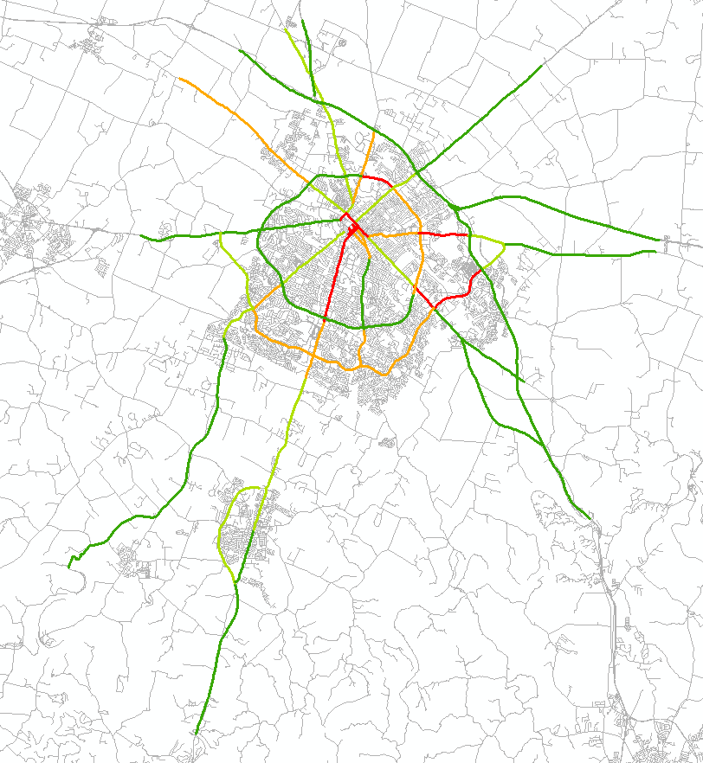
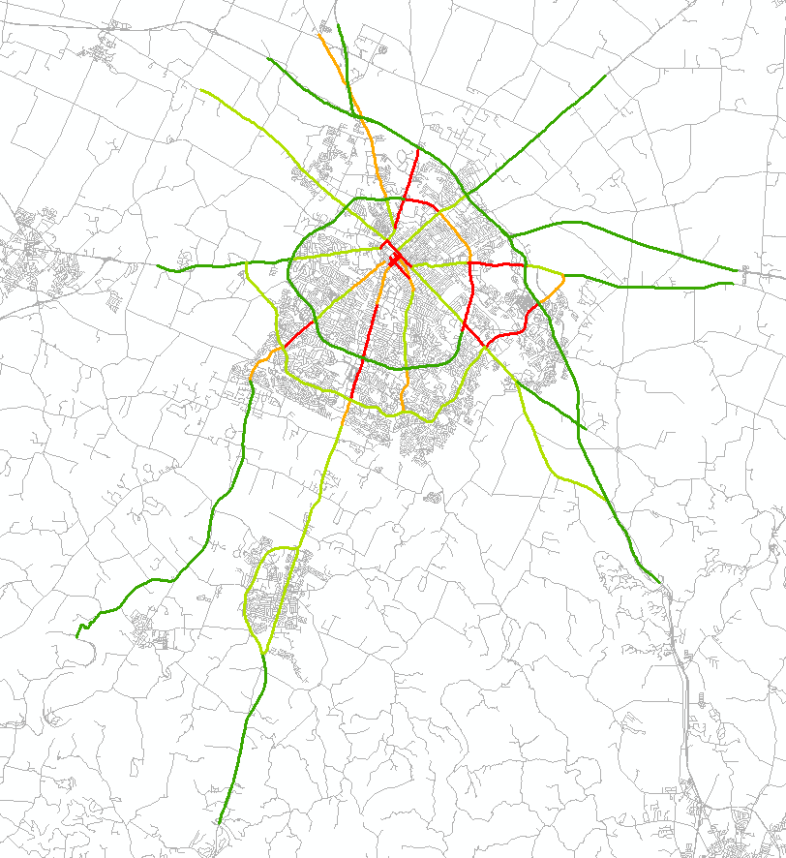
Travel Time- Statewide Data
2011 PM Cardinal Direction
2012 PM Cardinal Direction
Notes:
This is an example of Lexington Corridors
Since 2011, KYTC has purchased speed data for nearly all roads in Kentucky. These are examples of mapping the available data that is available using GIS portal maintained by the University of Kentucky. In these examples, Speed Limit was used as the “Normal” or Reference Speed. Nicholasville Road (use a laser pointer if you have one) appears RED in these peak PM charts. These are known as Travel Time Indices; they describe the longer travel time during peak hours. The RED segments take more than 60% longer during the afternoon peak traffic than during off peak times or when you are able to go the speed limit. Man-O-War appears ORANGE in 2011 and improves to LIGHT GREEN in 2012. We need to be careful; while it seems Man O War has improved it could be due to a change in posted speed. Tates Creek Road which is GREEN in 2011 degrades to LIGHT GREEN in 2012, suggesting a reduction of travel speed of roughly 5 mph.

Slide 28
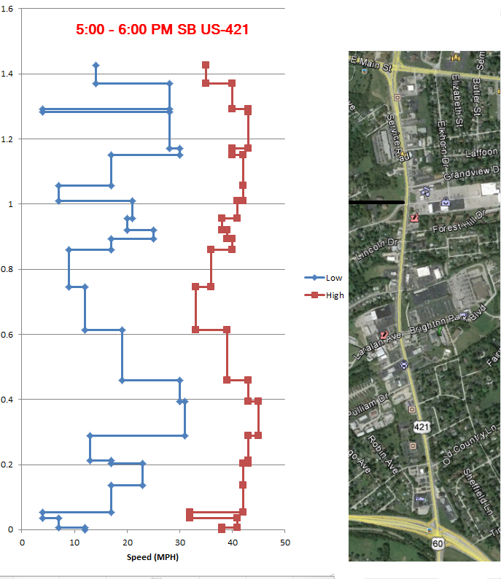
Travel Time - Corridor Profiles
Blue are Minimum Speeds
Red are Maximum Speeds
Arrow is the direction of travel at Average Speed
Notes:
Zooming from regional area, to a single corridor. Here is a 1.6-mile corridor, US-60 in Frankfort between the East-West Bypass and US-460-Georgetown Road. This example was developed for a FHWA Pedestrian Safety Study.
The areas that had wide ranges in speed are less safe for pedestrians. Here the individual segments of the data can be seen as breaks create the horizontal bars in the graphs.
In the morning (left graph) you can see the effect of the signals in the middle and how approach speeds degrade as you proceed into town.
Looking at the chart a different way, the wider the gap between Max and Min suggests choke points.
The range of customization is only limited by your imagination!

Slide 29
This is the End
Questions?
Comments?
Josh.Wentz@ky.gov
502-782-5090

